Slide 1
Module 1: An Overview of United Nations Peacekeeping Operations
Lesson
1.1
United Nations Peacekeeping

Slide 2
Relevance
As peacekeeping personnel you:
Represent the UN
Carry out decisions made at UN Headquarters in New York
UN Core Pre-Deployment Training Materials 2017

Slide 3
Learning Outcomes
Learners will:
Explain the UN and its purpose
Identify the UN Charter as the guiding document
List principal organs involved in UN peacekeeping
List departments active in UN peacekeeping
Describe three levels of authority for decision-making in UN peacekeeping
UN Core Pre-Deployment Training Materials 2017

Slide 4
Lesson Overview
An Introduction to the UN
Principal Organs of the UN Involved in Peacekeeping
Departments of the Secretariat Active in Peacekeeping
Strategic, Operational & Tactical – Levels of Authority in Peacekeeping
UN Core Pre-Deployment Training Materials 2017

Slide 5
Learning Activity
1.1.1
Film: United Nations Peacekeeping
Instructions:
What did you learn from this film?
What images stay with you?
What was interesting?
Time: 10 minutes
Film: 2:17 minutes
Discussion: 5-7 minutes
https://www.youtube.com/watch?v=st12PMiFg4Y
UN Core Pre-Deployment Training Materials 2017

Slide 6
Learning Activity
1.1.2
Consequences of Violent Conflict
Instructions:
Place yourself in your home country, in your own home, with your family
Imagine how a violent conflict would affect your life
Time: 15 minutes
Visualization: 5-7 minutes
Brainstorming: 5-7 minutes
UN Core Pre-Deployment Training Materials 2017

Slide 7
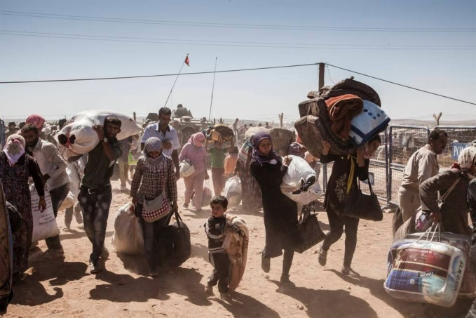
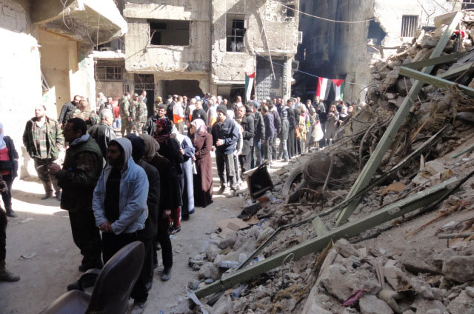
1. An Introduction to the UN
Violent conflict is devastating
Peacekeeping preserves peace when conflict ends
UN Core Pre-Deployment Training Materials 2017

Slide 8
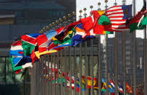
The United Nations
Universal and impartial international organization
Founded in 1945 after World War II
“[…]to save succeeding generations from the scourge of war[…]” (Preamble of the UN-Charter)
UN Core Pre-Deployment Training Materials 2017

Slide 9
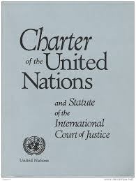
UN Charter
Founding document
Defines main purposes and principles
“Maintain international peace and security” – a main purpose
UN Core Pre-Deployment Training Materials 2017

Slide 10
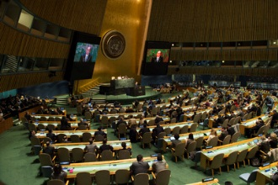
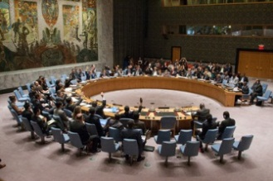
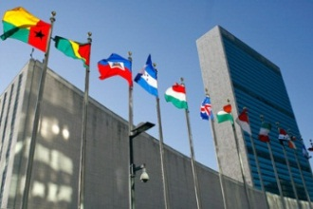
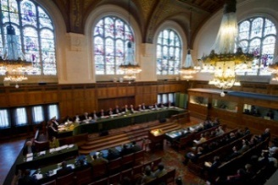
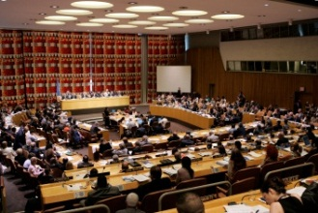
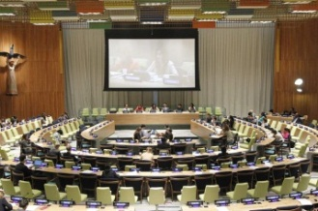
Principal Organs
General Assembly
International Court of Justice
Security Council
Economic and Social Council
Secretariat
Trusteeship Council
UN Core Pre-Deployment Training Materials 2017

Slide 11
UN Specialized Agencies, Funds & Programmes
UN Core Pre-Deployment Training Materials 2017

Slide 12
2. UN Principal Organs
Involved in Peacekeeping
General Assembly
Security Council
Secretariat
UN Core Pre-Deployment Training Materials 2017

Slide 13
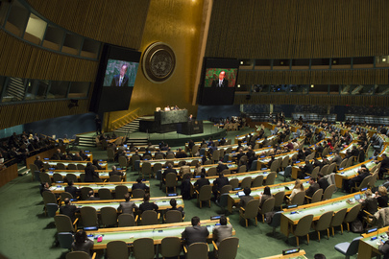
General Assembly
General Assembly
Main forum for Member States to make decisions
Committees, e.g. C-34
UN Core Pre-Deployment Training Materials 2017
7

Slide 14
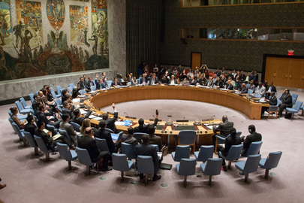
Security Council
Security Council
Primary responsibility for maintaining international peace and security
Power to investigate threats and take appropriate measures
UN Core Pre-Deployment Training Materials 2017

Slide 15
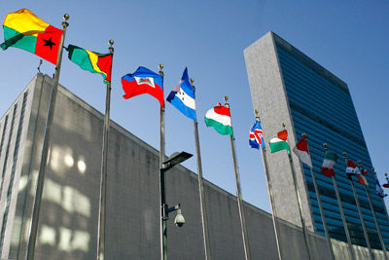
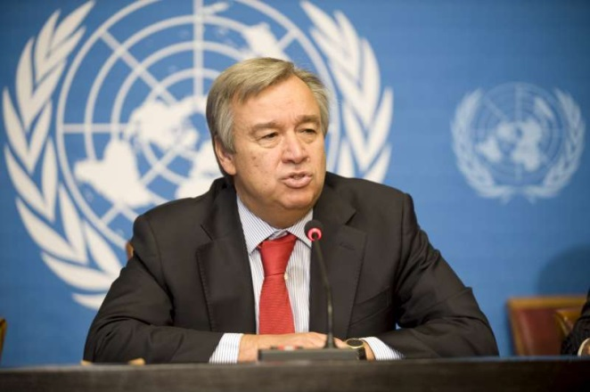
Secretariat
Secretariat
Secretariat: led by Secretary-General
Secretary-General: “Chief Administrative Officer” of the Organization
UN Core Pre-Deployment Training Materials 2017
9

Slide 16
3. Secretariat Departments
Active in Peacekeeping
Security Council
Secretary-General
Secretariat
USG DFS
USG DPKO
USG DPA
DFS
DPKO
DPA
UN Core Pre-Deployment Training Materials 2017

Slide 17
Department of Peacekeeping Operations (DPKO)
Executive direction of peacekeeping operations
Security Council
Secretary-General
Secretariat
USG DFS
USG DPKO
USG DPA
DFS
DPKO
DPA
UN Core Pre-Deployment Training Materials 2017
11

Slide 18
Department of Field Support (DFS)
Delivers support to UN field missions
Finance, personnel, administration, information and communication technology, logistics
Security Council
Secretary-General
Secretariat
USG DFS
USG DPKO
USG DPA
DFS
DPKO
DPA
UN Core Pre-Deployment Training Materials 2017
12

Slide 19
Department of Political Affairs (DPA)
Substantive direction to Special Political Missions
Collaborates with peacekeeping missions – political analysis, electoral assistance
Security Council
Secretary-General
Secretariat
USG DFS
USG DPKO
USG DPA
DFS
DPKO
DPA
UN Core Pre-Deployment Training Materials 2017

Slide 20
4. Strategic, Operational & Tactical
Levels of Authority in Peacekeeping
General Assembly
Security Council
Secretary-General
Strategic
Secretariat
(DPKO, DFS, DPA)
Head of Mission
Mission Headquarters & Leadership Team
Operational
Component Heads
Civilian Units
Tactical
Military Units
Police Units
Regional Offices
UN Core Pre-Deployment Training Materials 2017

Slide 21
Summary of Key Messages
UN maintains peace and security
UN Charter is the guiding document
General Assembly, Security Council, Secretariat involved in UN peacekeeping
DPKO, DFS, DPA active in UN peacekeeping
Strategic, operational, tactical - levels of authority for decision-making in UN peacekeeping
UN Core Pre-Deployment Training Materials 2017

Slide 22
Questions
UN Core Pre-Deployment Training Materials 2017

Slide 23
Learning Activity
Learning Evaluation
UN Core Pre-Deployment Training Materials 2017

